Slide 1
SPRING CORE

Slide 2
Table of Content
1
What is DI
2
What is IoC
3
What is Bean
4
What is AOP
5
Spring MVC

Slide 3
What is DI

Slide 4
What is DI
Dependency Injection (DI) is a design pattern that removes the dependency from the programming code so that it can be easy to manage and test the application. Dependency Injection makes our programming code loosely coupled.

Slide 5
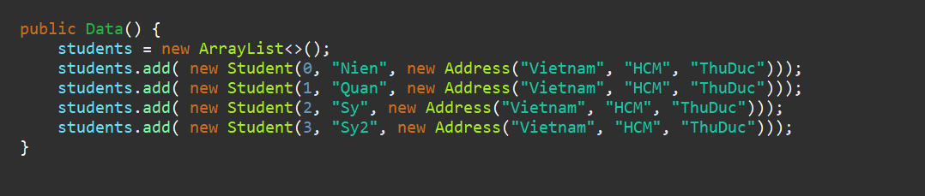
Why must use DI
DI helps reduce dependencies between objects and makes it easy to change dependent objects without affecting other objects.

Slide 6
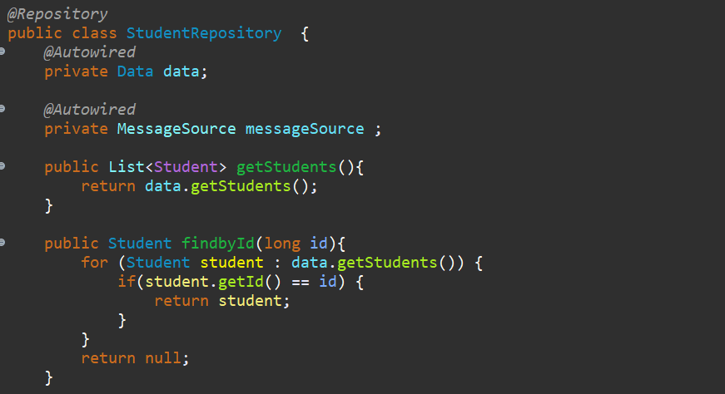
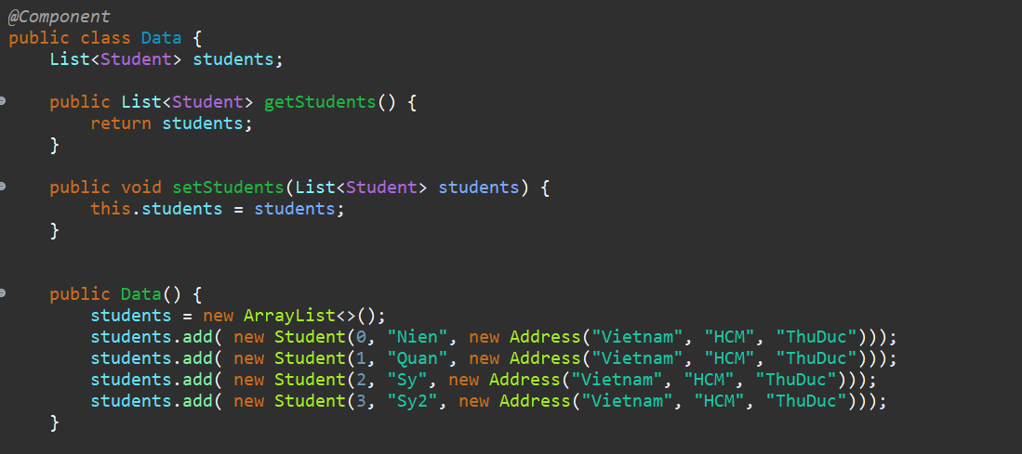
How to use DI
DI is done by defining beans in an XML configuration file or by using Java annotations to mark classes and methods. Spring uses Setter, Constructor or Field Injection methods to inject objects that depend on the object to be used.

Slide 7
What is IoC

Slide 8
What is IoC
IoC is a type of software design that allows the components of an application to be decoupled and that these components can be managed and automated. Spring Framework uses IoC to manage application components such as beans.

Slide 9
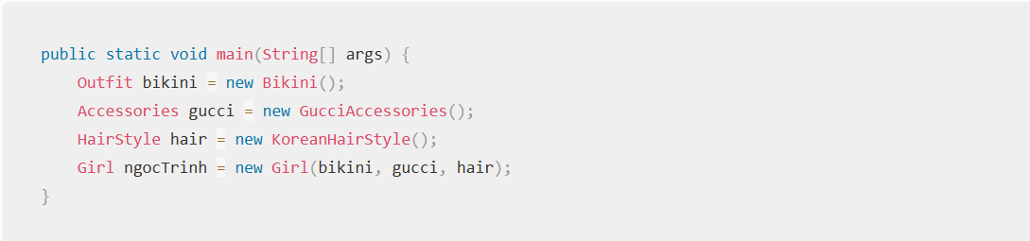
Why must use IoC
IoC helps reduce dependencies between application components, making it easy to change components without affecting other components.

Slide 10
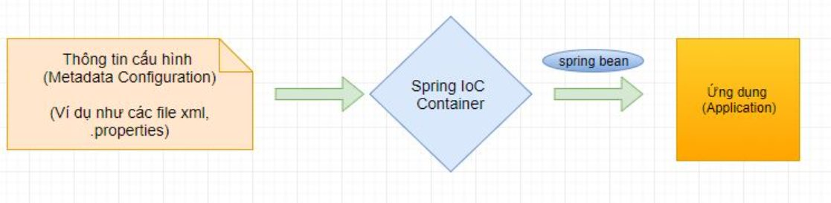
How to use IoC
In Spring Framework, IoC is implemented by defining beans in XML configuration file or by using Java annotations to mark classes and methods.

Slide 11
What is Bean

Slide 12
What is Bean
In the Spring Framework, a Bean is an object that is managed by the container (or context), and is used to provide dependencies to other components in the application.

Slide 13
Why must use IoC
Using Bean in Spring Framework helps to reduce dependencies between application components, making the source code easier to read, understand and maintain. In addition, Bean supports features such as Singleton, Lazy Initialization, Dependency Injection, and AOP.

Slide 14
How to use Bean
A Bean in Spring Framework can be created in many different ways, for example through defining the bean in an XML file or through annotations like @Component, @Service, @Repository, and @Controller.

Slide 15
What is AOP

Slide 16
What is AOP
AOP (Aspect-Oriented Programming) is a programming paradigm that allows separating cross-cutting concerns from the main business logic of an application. Cross-cutting concerns are the features or functionality that impact the entire application, such as logging, security, and transaction management.

Slide 17
Why must use AOP
1
Modularity
3
Separation of concerns
2
Reusability
Notes:
Bằng cách tách các vấn đề chung khỏi logic chính của ứng dụng, AOP cung cấp một cách tiếp cận module hóa hơn cho phát triển ứng dụng. Aspect có thể được phát triển và kiểm thử độc lập, sau đó được kết hợp với logic chính của ứng dụng.
Khả năng tái sử dụng: Aspect có thể tái sử dụng trên nhiều ứng dụng, giảm lượng mã trùng lặp và cải thiện tính bảo trì.
Tách biệt vấn đề: Bằng cách tách vấn đề chung khỏi logic chính của ứng dụng, AOP cải thiện tính đọc mã nguồn và làm cho việc thay đổi và kiểm thử mã nguồn dễ dàng hơn.

Slide 18
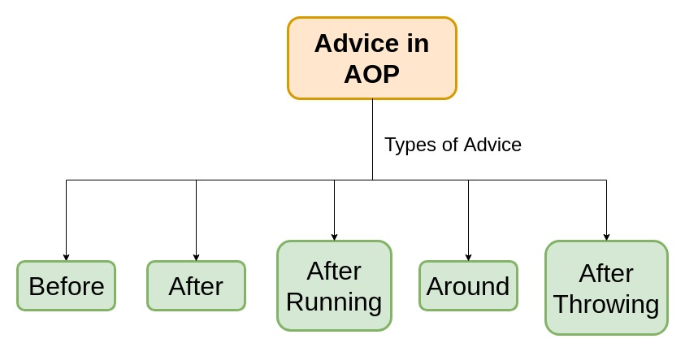
How does AOP work?
AOP works by intercepting method invocations or events and injecting additional behavior before, after, or around the method or event. This is achieved using aspects, which contain advice and pointcuts.

Slide 19
What Spring MVC

Slide 20
What is Spring MVC
Spring MVC is a web development framework based on the MVC pattern that provides a flexible approach to developing Java web applications. It provides features and functionality such as HTTP request handling, session management, routing, error handling, and database interaction.

Slide 21
Why Spring MVC?
1
Reduce code complexity
2
Save time
3
Good integration with other frameworks
4
Flexibility

Slide 22
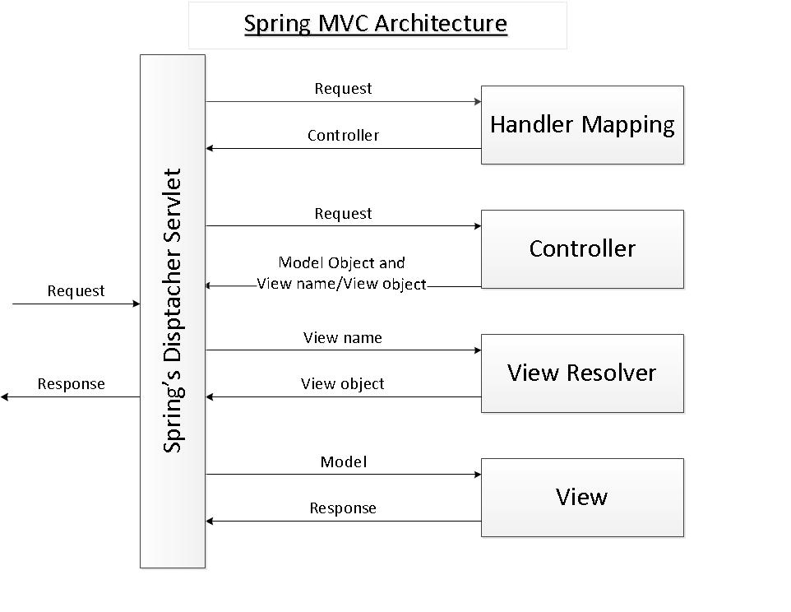
How to Spring MVC work

Slide 23
What is Lombok

Slide 24
What is Lombok
Lombok is a Java library used to reduce the amount of repetitive code in regular Java classes by dynamically generating getter, setter, constructors and other methods.

Slide 25
Why Spring MVC?
The main reason to use Lombok is to minimize code repetition in Java classes. Code repetition can lead to errors such as incorrect method or field names, causing bugs that are hard to test.

Slide 26
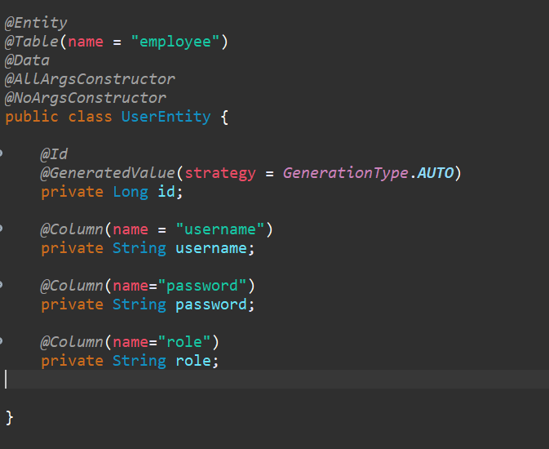
How to use Lombok

Slide 27
Thank You

